Slide 1
Navigating Microservices with ASP.NET Core
Ryan Nowak - @aVerySpicyBoi

Slide 2
Who am I?
Framework designer/architect working on:
ASP.NET Core (many parts of it)
Blazor
My role is about:
Making developers more productive
Direction and features of ASP.NET Core
Performance ☺
I’m not an app developer, I’m a framework and tools developer
Find me/us:
Twitter: @aVerySpicyBoi
Github: https://github.com/dotnet/aspnetcore
Presentations: https://github.com/rynowak/Presentations

Slide 3
Agenda
What is Kubernetes?
How does ASP.NET Core help me?
Performance

Slide 4
What are microservices?
Are they just very small services?
Small amounts of code?
Small numbers of concepts?
Do I need different frameworks and libraries?

Slide 5
🤷 No, but sometimes kinda maybe? 🤷

Slide 6
Is this even good?
Main idea: break up a large application into separate business domains that make sense
For division/specialization of labor
To move at different speeds
To modernize gradually
To plan, code, and deploy separately
To be cool
If you’re not getting these benefits… run!
I’m not a salesman, so I’m not going to sell you anything
A lot has been said about the philosophy, I’m going to focus on the tech
Microservices might not be right for your project/team/company

Slide 7
Backend Development
Microservices
How I think about microservices as a framework developer…
Most Stuff is here

Slide 8
If you’re with me so far, what do you need to know?
You must choose a deployment environment
Lots of small problems get turned up to 11
Developer productivity is unsolved, but not unsolvable
You need good diagnostics

Slide 11
Why Kubernetes
It’s the current trend
It’s more sophisticated and powerful
Kubernetes is a platform – more will be built on top

Slide 12
Demos: Kubernetes
Notes:
Start [7m]
End [13m]

Slide 13

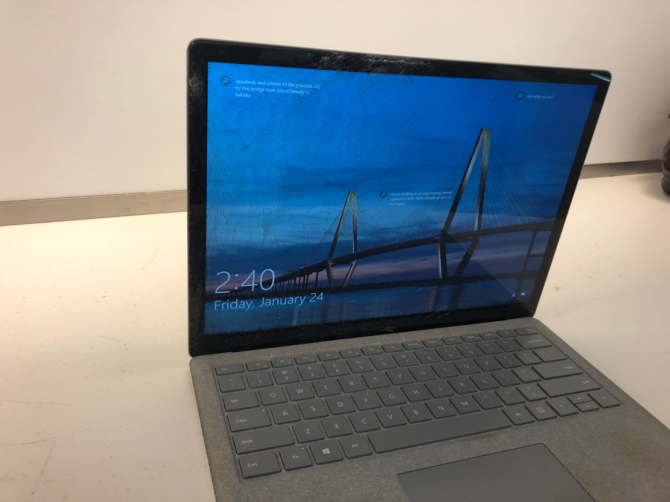
I was planning to show a mix of Windows and Mac to prove it to you. Windows works fine if you don’t physically smash your computer. WSL2 makes Docker/K8S really good!

Slide 14
Kubernetes as a platform
As a developer there’s lots to like about k8s
Deployment assets can be source controlled!
Everything is scriptable/toolable
Everything is extensible
It’s a big REST API
There’s also lots that’s not great
Docker and other deployment tools can still be painful
There’s lots of concepts, maybe more than you need

Slide 15
Your menu for microservices
How do you communicate?
How does one service find another?
How do you manage secrets and configuration?
How do you visualize problems?
How do you monitor performance?
Most of these questions exist without microservices, but now they are multiplied ☺

Slide 16
Blazing Pizza
Menu
Blazor Client App
Frontend
Orders
Delivery
HTTP + JSON
gRPC
Redis
Notes:
Start [17m]

Slide 17

Performance

Slide 18
The experiment
We know ASP.NET Core can perform well for high throughput scenarios.
What about the performance with small amounts of resources?
This is useful for cases where you want to deploy lots of low-traffic applications.
OR for building cloud-native infrastructure.

Slide 19
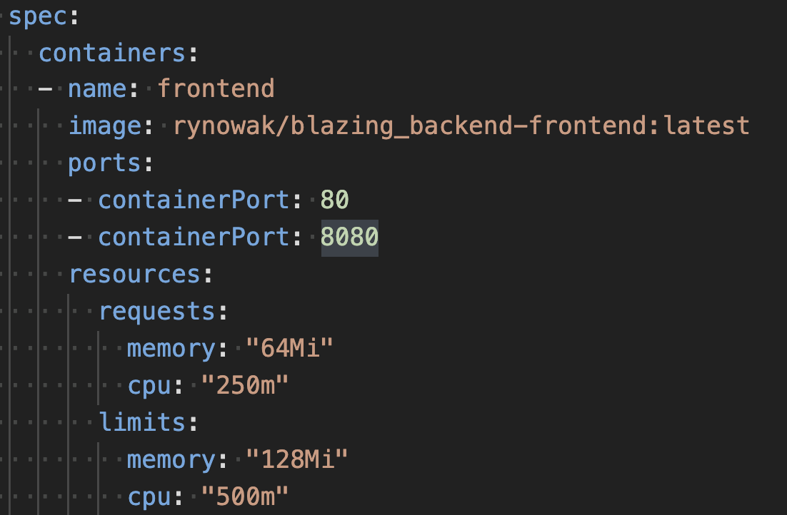

Slide 20
The experiment
Writing the same app in a bunch of different mainstream frameworks/techs
Go
Python
Java
.NET
Testing fixed amounts of RPS
Varying the size (CPU x Memory) using Docker’s settings
Measuring
Latency
Working Set
CPU usage
% of traffic actually served

Slide 21
The experiment
Meant to simulate a typical *small* infrastructure piece
Serving a small JSON payload
Calling another service to get back some JSON
Includes a fix amount of delay from the other service
More Info: https://github.com/rynowak/benchmarks-playground

Slide 22
Want to see results?
No benchmarking exercise is perfect
I did this for science! Not to trash other technologies
Not every technology claims to be good for everything

Slide 31
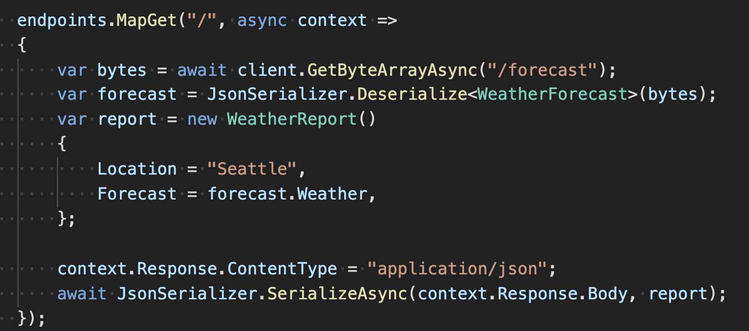
Route to code

Slide 32
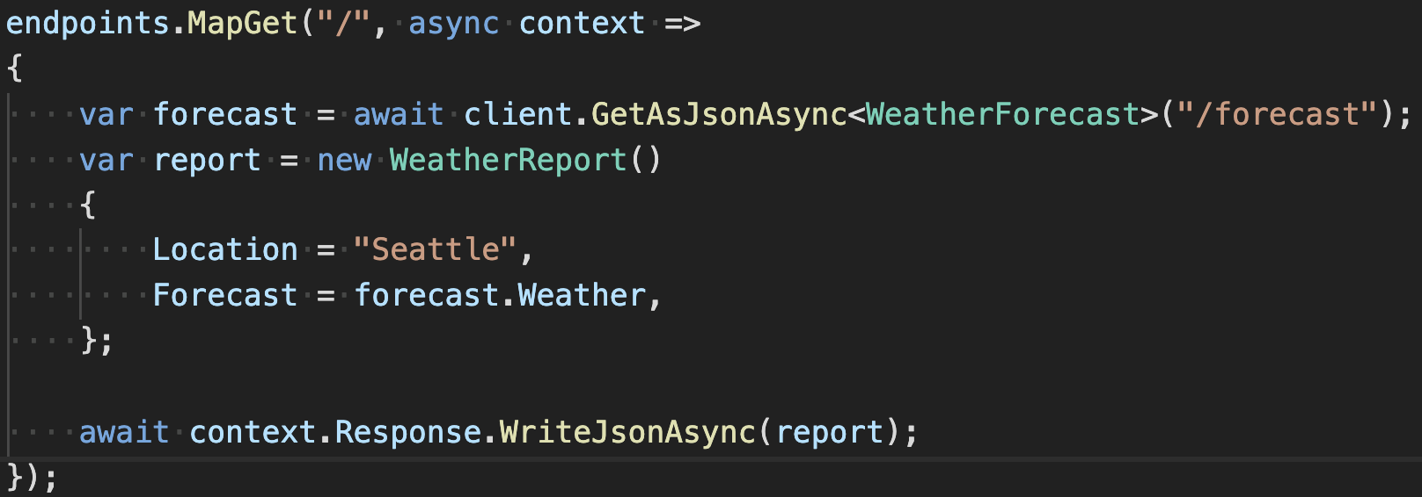
Route to code
3.1
5.0

Slide 33
Conclusions
.NET Core can work surprisingly well with small amounts of memory
ASP.NET Core can be:
High throughput + density if written at a low level of abstraction (route-to-code)
Low throughput + density with richer frameworks (controllers)
We’re working on docs + guidance for this kind of scenario

Slide 34
The end
Twitter: @aVerySpicyBoi https://github.com/rynowak/Presentations
https://github.com/rynowak/blazing-backend
https://github.com/rynowak/benchmarks-playground

